Slide 1


the
Canadian Chamber of Commerce in Latvia
(CanCham)
Connecting Canada and Latvia

Slide 2
Objective
Develop business opportunities

Slide 3
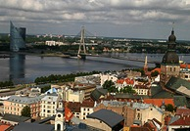
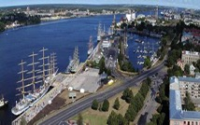
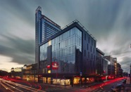
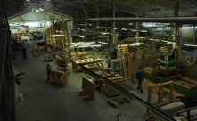
Why Latvia?

Slide 4
2,000,000 population?
WOW!

Slide 5
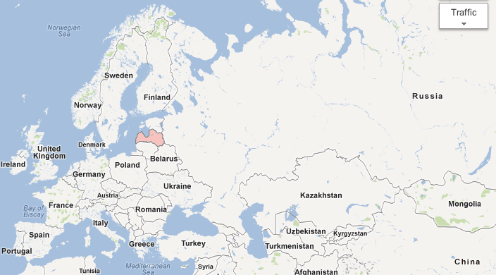
  Latvia is positioned for potential
Population:
Total EU 499.8
Canada/US 345.8
Population:
Russia 142.9
Ukraine 45.9
Belarus 9.5
Total East 198.3

Slide 6

  Latvia is the commercial hub of Northern Europe
    It is the financial centre of Northern Europe
      23 banks
      the Luxembourg of the north
    Established traditions in
      banking,
      manufacturing,
      education and
      development

Slide 7
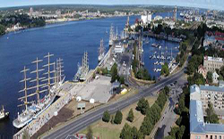
  Unique geographic location
  Geographic centre of Northern Europe
  Bridge between east and west with excellent ties both ways
  Key point of entry: Canada/US > Russia, Ukraine, Belarus
Canada/US > EU
Russia, Ukraine, Belarus > EU and Canada/US
EU > Russia, Ukraine, Belarus
  Why ??? –
        because Latvia has the ONLY
        ice-free ports
        in the Baltic Sea

Slide 8
  Stable, predictable financial climate
Considered a western state that must abide by EU regulations
    Joined the EU and NATO in 2004
    2010, government of Latvia initiated austerity programs as demanded by the IMF
      Stabilized economy which resulted in growth in 2011
in December, 2011, Latvia was recognized as a good place to invest by the International Monetary Fund (IMF)
Shared values with North America and trust in Canadians
The Result – a favourable business climate

Slide 9
  History: Why then, why now?
What was then…
• A centre of commerce and industrial production for the
Russian Empire (before 1917) and the Soviet Union (1940 to 1990)
• A prosperous economy based on manufacturing (1918 to 1939)
• Gained independence in 1991 and converted from a planned economy
• Economic transition saw challenges from banking crises and economic
boycotts by Russia
• Saddled by unfamiliarity with western (particularly European) practices and
politically-related development issues

Slide 10
And what lately?
Because recent changes = new markets
2017
  CETA
  Canadian NATO Deployment in Latvia
  CAF European Central Command in Riga
  NAFTA

Slide 11
  History: Why then, why now?
What is now…
A financially and politically stable country
with a growing economy, an ideal location,
shared values with North America and
an infrastructure of chemical and pharmaceutical manufacturing,
that is driven by various
needs and conditions that favour business activity.
A market ripe for entrepreneurs
Latvia, the Baltic region and Europe offer unique business opportunities.

Slide 12

EU Business Centre in Riga, Latvia
500 employees in Riga and 100 inIT in Poland

Slide 13
Objective
Develop business opportunities
Between Northern Europe and Canada
Serve as bridge between
  the EU,
  North America, and
  Russia/Central Asia/Ukraine/Belarus

Slide 14
How?
Develop strategic partnerships for
export of goods & services from Latvia
export of goods & services from Canada
Collaboration on international projects

Slide 15




Networking

Slide 16













Business Opportunities

Slide 17
Team Latvia

Slide 18
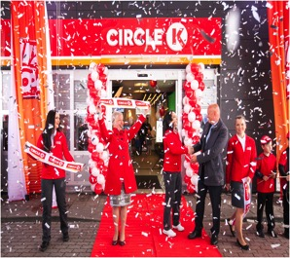

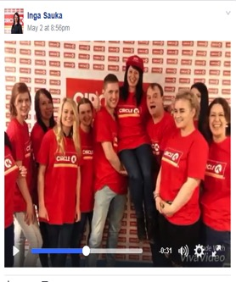

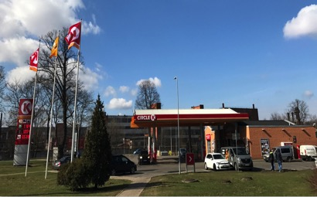

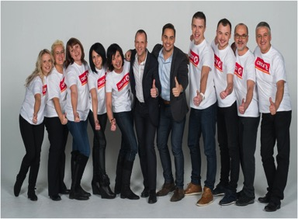
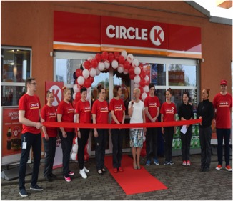
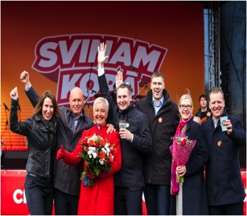
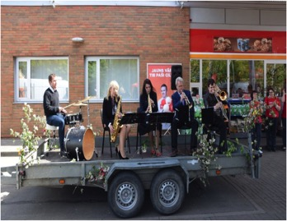

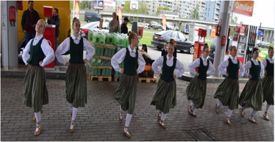
RE-branding

Slide 19

Valters Kronbergs

Slide 20

SIA “VPH LATVIA“
Head office in Vilnius, Lithuania, branch in Riga, Latvia
Contact person: Barry Nabuurs, e-mail: b.nabuurs@vph.lt, phone no.: +370 631 19167
WHAT WE DO:
We develop commercial real estate for international and strong domestic retailers across the Baltics and in Canada
We provide asset management services – a partner with SNC-Lavalin O&M for 4 years
We always employ a „tenant first“ approach in our developments
We have developed more than 160,000 sqm valued at more than EUR 200 million
Currently, we have over EUR 200 million of projects in the pipeline in the Baltics and Belarus
We also leverage our 25+ years of experience to structure deals outside the real estate sector
WHAT WE ARE LOOKING FOR:
Potential investor partners and tenants from Canada for real estate projects
Companies which need assistance to structure opportunities and complete deals in the Baltic market

Slide 21
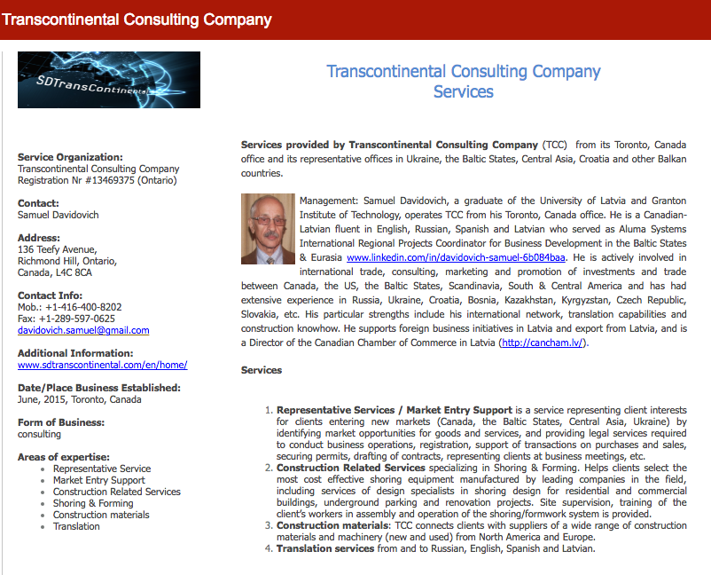

Slide 22
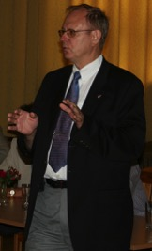











Ed Kalvins
Technical Partners
a Canadian company, established in 1992 focused on
Latvia and Northern Europe
bringing Canadian products and expertise to Latvia
specializing in project management, monitoring consultancy and representative services,
and representing
Technical Partners International Inc. CANADA • LATVIA • SAUDI ARABIA • TURKEY • UKRAINE • UNITED KINGDOM

Slide 23
Pēteris Brauns

Slide 24
Pēteris Ruģelis and Elmārs Tannis

Slide 25

Harijs Ozols

Slide 26

Tālis Kivlenieks
Father....Antons Kivlenieks (1924-1964), born in Kalupe, Latvia
1945 Emigrated to Canada as a DP
1957 Founded Kalupe Jewellery Ltd. Toronto
Son.....Talis ....Born 1956, Toronto
Moved to Latvia ..June 2008.
www.kalupesrotas.lv

Slide 27


ABENS KONSULTANTS

Slide 28

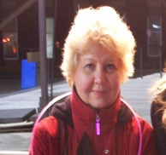


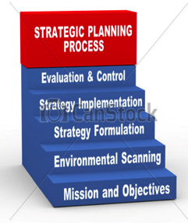
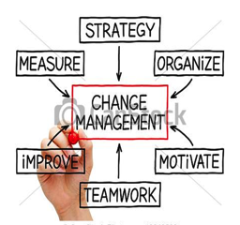
Inta Consulting

Slide 29
A Canadian Influence

Slide 30
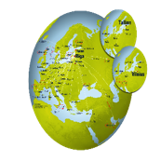


airBaltic - 2017 highlights
7 brand new Bombardier CS300 aircraft enter service
13 launched routes, including Abu Dhabi and a domestic service to Liepāja
Strongest summer in history – record high revenue as well as number of passengers
KPIs | 2017 H1 | 2016 H1 | Delta | Ind
Revenue (M EUR) | 152.0 | 127.0 | 25.0 | +20%
Passengers ('000) | 1,600 | 1,300 | 300 | +20%
Load Factor | 73% | 71% | 2 pp | +2%
Fleet | 30 | 24 | 6 | +25%
Seat Capacity ('000) | 2,222 | 1,894 | 328 | +17%

Slide 31


Slide 32
Working with Canadians

Slide 33
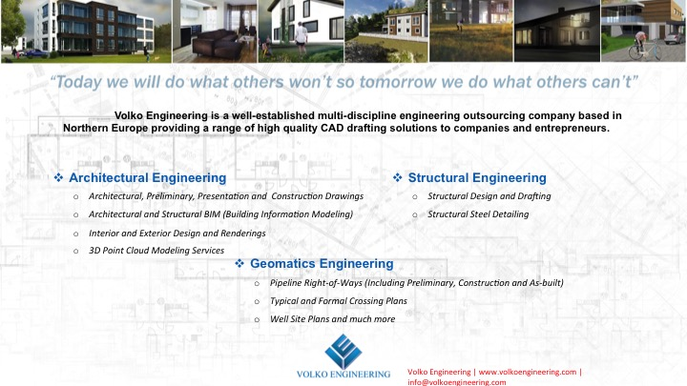

Slide 34

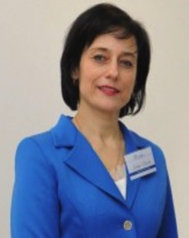


Dr. Kintija Barloti
SIA «Dr. Barloti»
CEO
Contact
+ 371 29409920
kintija.@barloti.eu
skype: kintija.barloti
www.barloti.eu
Business Development and Marketing
New medical clinic development
Medical Tourism Management
Pharma Brand development & management
Regulatory affairs (EU guidelines)
Baltic States, Russia, Ukraine, Kazahstan, Poland, Canada, Uzbekistan, Georgia

Slide 35

Accounting services in Latvia.
Dzintra Renigere
MBA
dzintra.renigere@rbirojs.lv
Tel. +371 29 225 128
Fully adapted to customer individual needs.
Remote access to your financial data.
English talking company.
www.rbirojs.lv

Slide 36

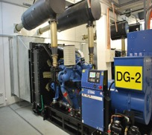
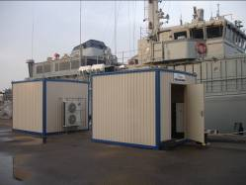
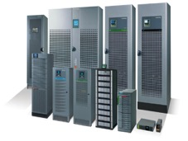
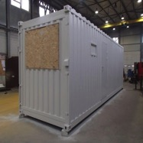




Leader in emergency and back-up power solutions in Latvia
Wide range of power supply products.
Power generators
UPS systems
Stand-by batteries
etc
Custom built containers for generators, photovoltaic systems, rectifier systems etc.
Experienced service team
Installation works
After-sales service
  Maintenance and supervision
  Spare parts
  Consulting
  Testing
Rental generator fleet on trailers with power of 6 to 1200kVA – available 24/7!

Slide 37

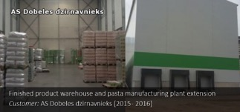
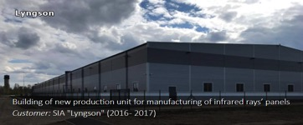
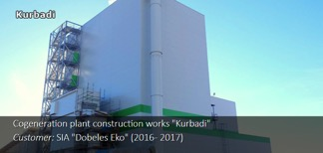
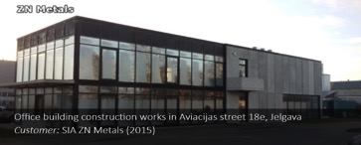
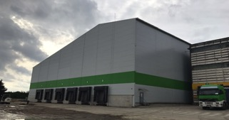
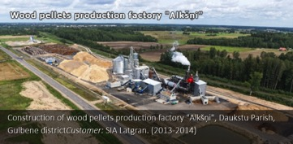
PK serviss SIA- Your construction company in Eastern Europe and Scandinavia!
See more on www.pkserviss.lv
Some of recent largest projects in Latvia:
I stage
AS Dobeles dzirnavnieks II stage
Ready-made products warehouse
Customer: AS Dobeles dzirnavnieks (2017)

Slide 38

TRULY ROYAL WITH THE BEST VIEW OF RIGA IN RIGA
354 ROOMS
10 MULTIFUNCTIONAL MEETING ROOMS, GARDEN AND AN OBSERVATION DECK
2 RESTAURANTS & AN INVITING LOBBY BAR
WELLNESS CENTRE WITH 24 M. INDOOR SWIMMING POOL
ON-SITE SECURED PARKING

Slide 39



Moving | Relocation | Move management | Immigration | Consultancy
Every move you make
www.gosselinmobility.eu

Slide 40

WE CREATE DESIGN. Our design stories have their roots deep in Finland’s forests that inspire us to create best conditions for every interior solution. Our innovations and new ecological production methods and materials combined with high-tech solutions and Nordic design make us unique. We have generated Finnish expertise, quality and industrial innovations since 1928. We are committed to ensuring that our customers are able to enjoy high-quality furniture while being confident that it has been produced responsibly.
Office
School
Health
Isku Office enables individual, active working environments. Ergonomic desks and office chairs, functional lobby solutions, soundscape controlled by design screens and space-saving storage solutions motivate employees and improve comfort in the working environment.
Isku School range create the setting for teaching and learning. Isku responds to demand with durable, individual and transformable furniture solutions. Isku Active Learning solutions help accommodate and support changes in functionality, without requiring changes to the space. Products have been specially designed to be easy to move, group and dock in different configurations in changing situations
Isku Health products increase environmental cleanliness and well-being. Isku is the first industrial operator to launch on the market antibacterial coatings for its furniture.Together with our partners we are able to realise hygienic environments in which the growth and spread of bacteria is checked.
www.isku.com
www.isku.lv

Slide 41


Slide 42


Slide 43
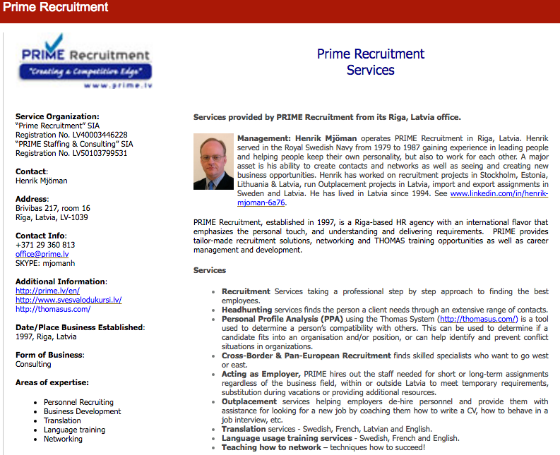

Slide 44

SIA Premium Food
Working mainly in the food and beverage industry with partnership, management, product development, sales, import and exports, based on 25 years of industry experience.
We are also involved in projects for car equipment producers in Asia.
Contact: John Ivar Lundberg
Mail: john@premiumfood.lv
Phone: +37125477899

Slide 45

RIPO International Ltd.
Thermoblock wall system
Insect screens
Roller shutters
Industrial doors
Garage doors
24 YEARS of EXPERIENCE
Established in 1993, the company RIPO has grown into one of the leading manufacturers of furniture and garage doors in Latvia. The potential and the key to the company’s business success are professional employees, highly qualified craftsmen and responsible attitude towards customers.
MANUFACTURING
The company RIPO carries out a complete cycle of manufacturing processes through advanced planning and manufacturing technology. The large production and storage facilities ensure maximum automation of the manufacturing process and increased flexibility in its production.
EXPORT
In addition of selling RIPO products in Latvia, we produce it for overseas markets for places like Norway, Sweden, Finland etc. There we usually work on large projects. Last year RIPO export grew by 40% , that being said we are still looking for new dealers who would like to sell RIPO products outside Latvia.

Slide 46
Smart Continent LV
One-stop shop for expertise of different kind: finance, engineering, public policy, etc.
We are ready to solve Your problems and answer to Your needs!
Consulting, expert services, research, evaluations, valuations, etc.
A growing network of 100+ PhDs, MScs and specialists in different fields at afordable rates are waiting for Your task.
Contact: CEO Gints Turlajs
gints.turlajs@smartcontinent.lv
GSM +371 29409509, Skype: gintst

Slide 47
Latvians and Canadians from Canada
Baiba Rubesa, Rail Baltica
Daniels Liepiņš, Trompete
Eriks Seminovs, CanCham
Guntis Brumelis, LU
Harolds Bulmanis, Sun Crisp
Harry and Ruta Whittaker, Ekosaule
Imants and Vaira Freibergs
Ivonna Bradley
Karl Sarkans, Geneva Capital
Klavs Zichmanis
Larry Chilton
Margita Gailitis
Māris Ozols
Martins Ritins, Vincents
Pauls Calitis, Air Baltic
Pauls Miklasevics, Baltikums Bank
Peteris Apse, Adenta
Uldis Hodgins

Slide 48
A Canadian Influence
Ainars Jekabsons, Ozollapas
Ainis Caunans, Apdares Studija
Aldis Pauga, Baltijas Helikopters
Andrea Balazsova, Bell Helicopter
Eduard Bondarenko and Mark Katz, Belam Riga
Gundars Bojars, VestaFume TLG
Robert Dewar, Bombardier
Romualds Gertāns, Rommila
Sam Davidovich, Transcontinental Consulting Company Ltd

Slide 49
Active Projects - General
Energy from waste
Private hospitals (2)
Retirement Village
Paper Mill
Hydrometallurgical plant
Medical devices
Mobile Lab for Water Monitoring
Business incubators

Slide 50
Active Projects - Construction
Rail Baltica
Open-air festival stage reconstruction
Construction of Hanza City financial centre
Reconstruction of New Riga Theatre
Renovation and development for Kaļķu street
Transformation of Daugava Sports Stadium
New logistics centre in Rāmava
Renovation of Kemeri sanatorium
Planning of bypass road for A7 highway
Electrification of railway network
“Rimi Baltic” to build a new central logistics hub in Latvia.
Planning and development of multimodal transport hub

Slide 51
Team Canada

Slide 52
Easter Business Mission to Latvia

Slide 53
Thank you

