Slide 1
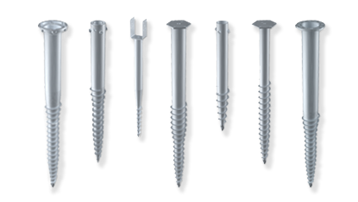

Slide 2
Screw foundations replace Concrete foundations

Slide 3
Applications

Slide 4
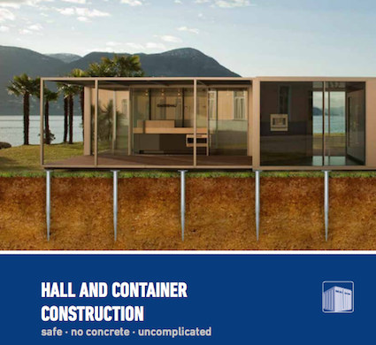

Slide 5
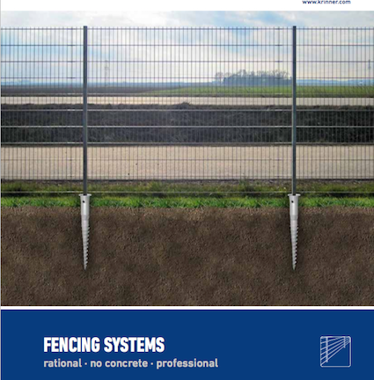

Slide 8
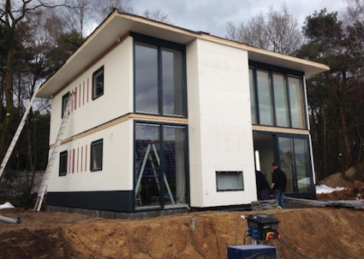

Slide 9
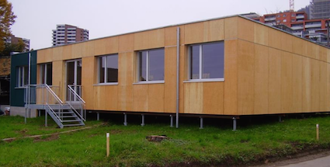

Slide 10
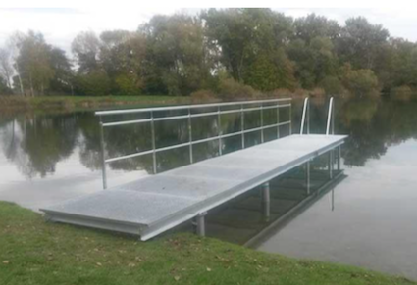

Slide 11
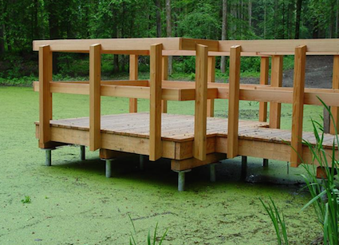

Slide 12
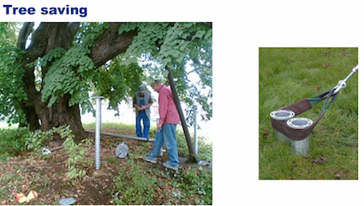

Slide 13
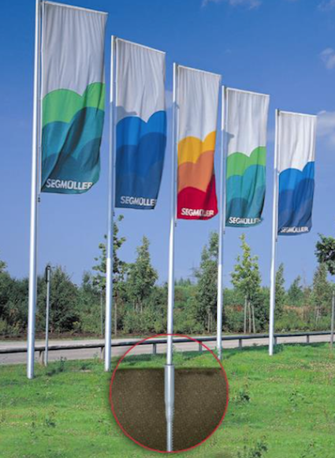
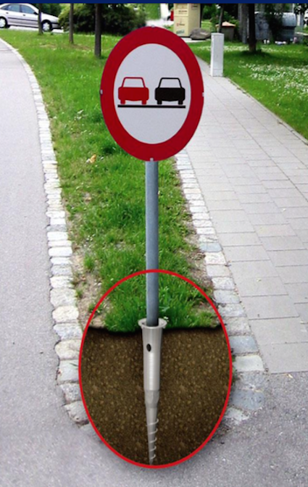

Slide 14
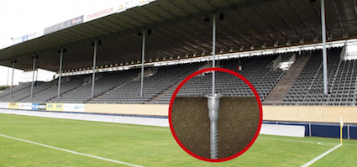

Slide 15
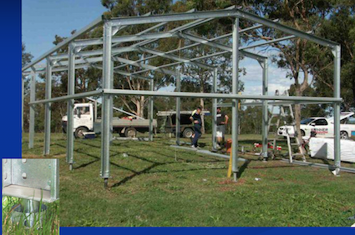

Slide 16
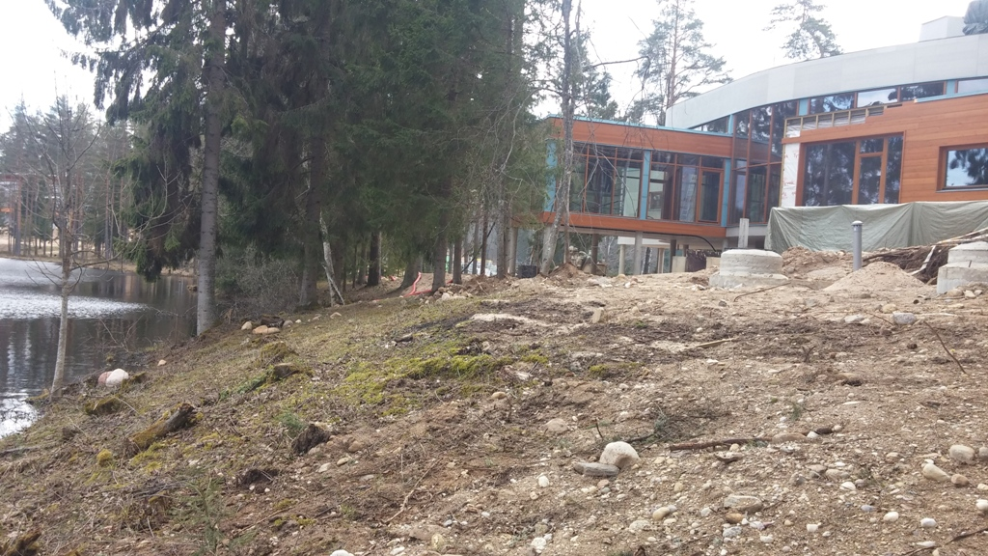

Slide 17
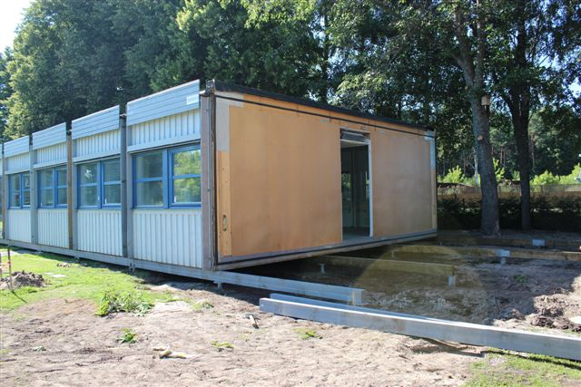

Slide 18
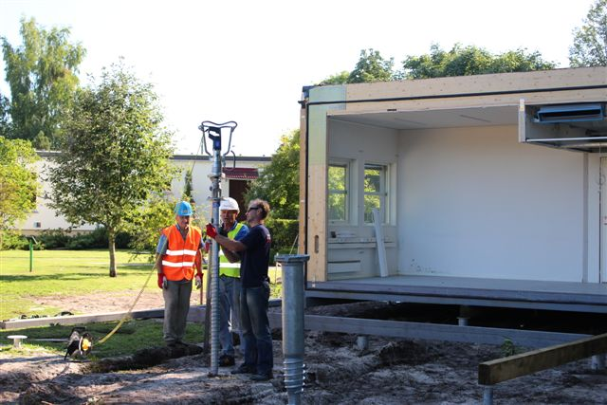

Slide 19
Screw foundation Structural analysis, Installation, Assembly Not weather dependent Removal, Reusable foundation
Enquiry
Planning
Proposals
Order
Set Up
Removal
Concrete foundation
Structural analysis, Excavation, Earthworks, Formwork, Reinforcement, Foundation, Concreting, Hardening, Revisit, Assembly, Repair damage
Weather dependent
Foundation removal, Steel/concrete separation, Disposal/recycling, Renaturation

Slide 20
Advantages Lower cost Save time Statistically proven No digging or concrete work Environmentally friendly Reusable

Slide 21
Clients Private sector – 50% Large clients - 50%

Slide 22
Help Sell Commissions 10% Referral fee 2% up to €2,000

Slide 23
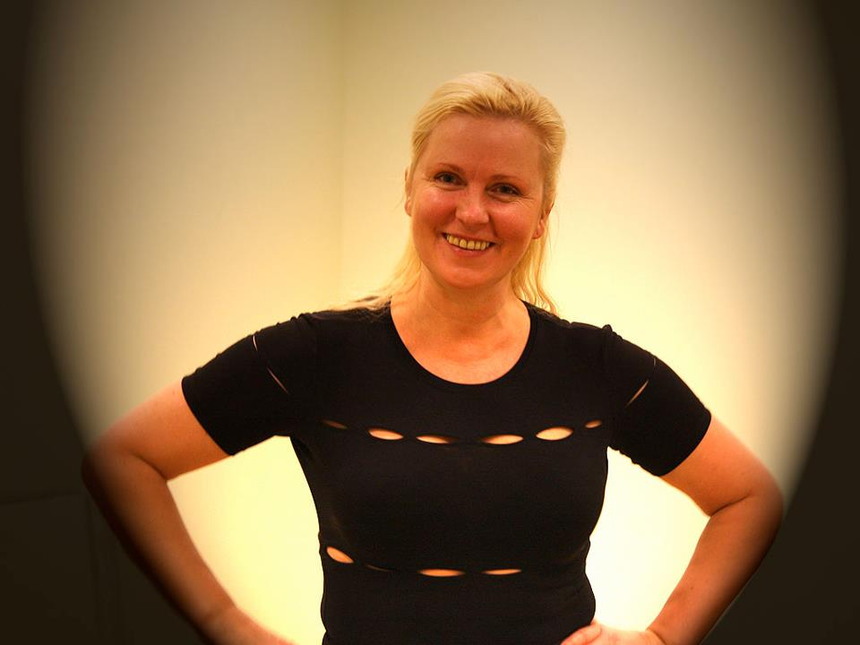
Daiga Štendenberga
Serving the Latvian market for 7 years

Slide 24
Daiga Štendenberga daiga@krinner.lv +371 20390825 Iztāžu iela 11, Kekavas pag., Kekavas nov., Izstāžu komplekss "Rāmava", LV-1076

Slide 25
Thank you for your attention

