Slide 1
“Breakthrough - is the essence of any development”
www.creapromo.com

Slide 2
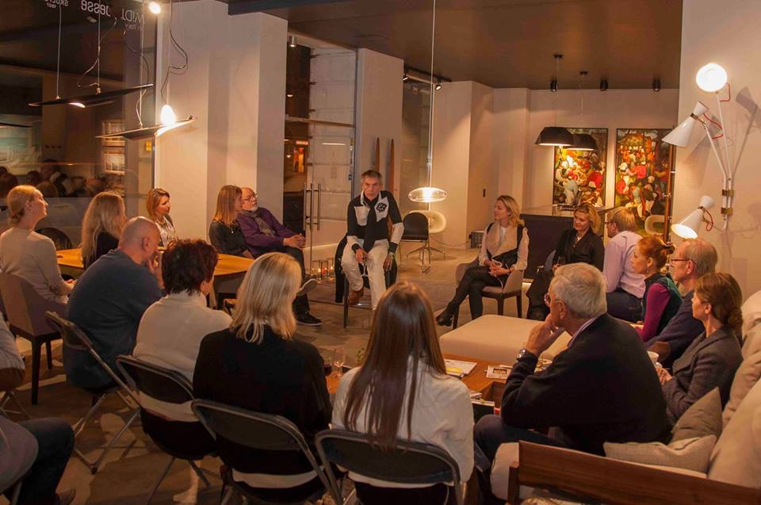
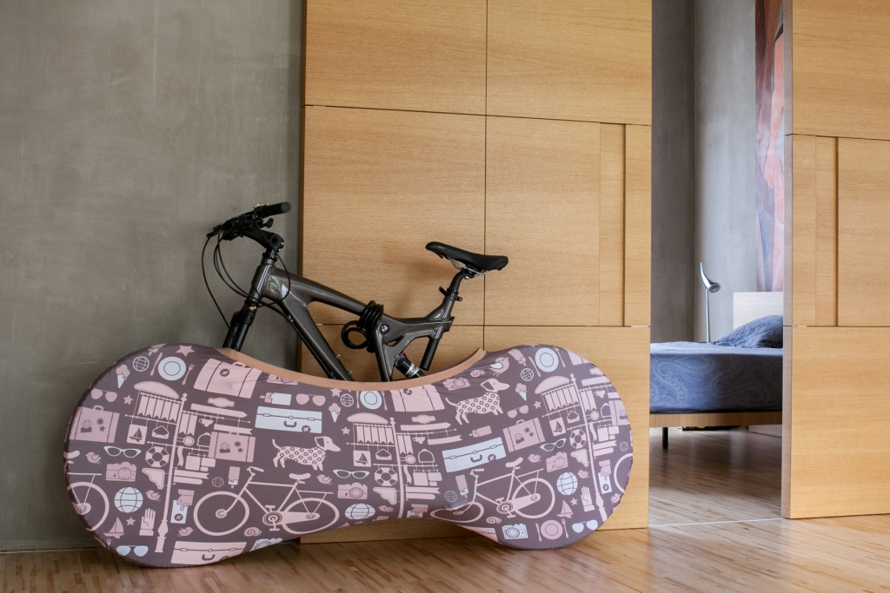
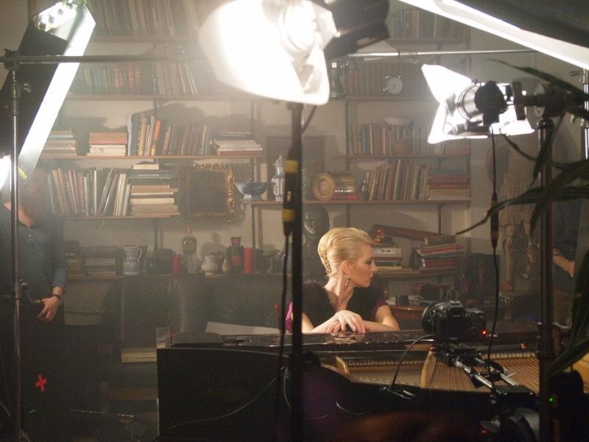
Our strategy is based on three-step principle:
- Analysis of existing tradition
- Required breakthrough
- New vision of the company

Slide 3
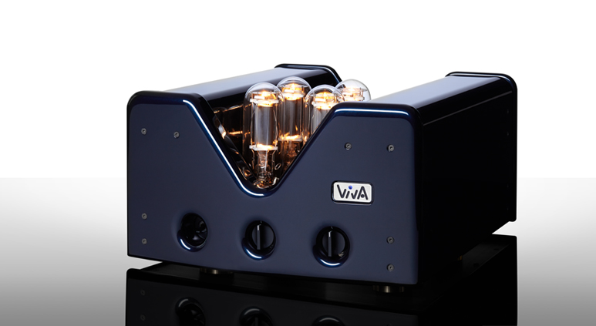
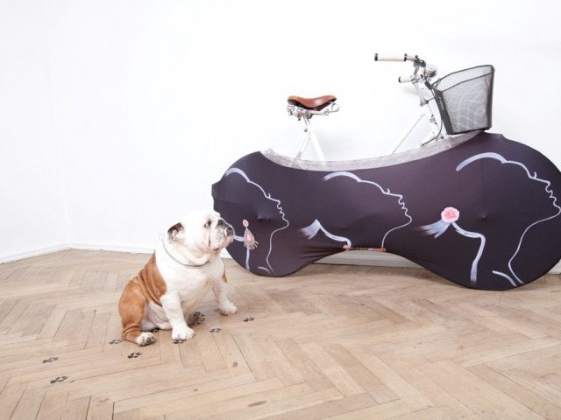
Services we provide:
Brand positioning
New products positioning
Media support
Market research
Integrated Marketing and PR Strategies
Storytelling development
Budget Evaluation
Using new and innovative channels of promotion
Creating media/visual platforms for your company
Events organisation and management
Film Production and Film shooting in Latvia
International Mentoring

Slide 4
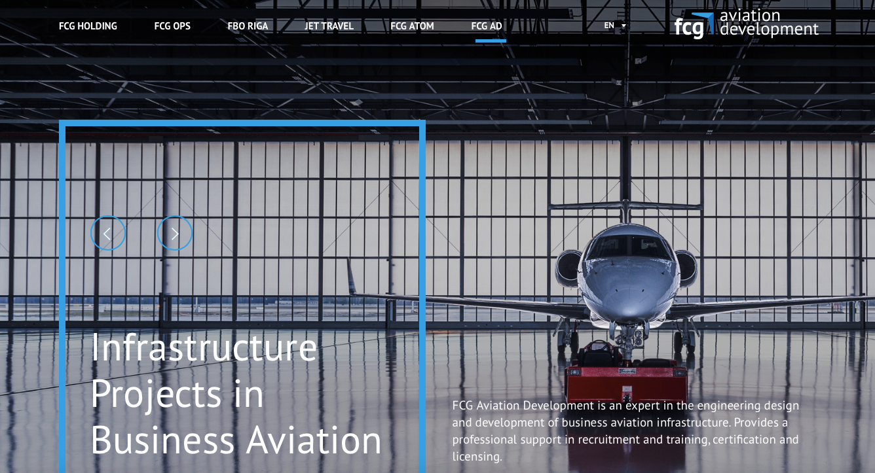
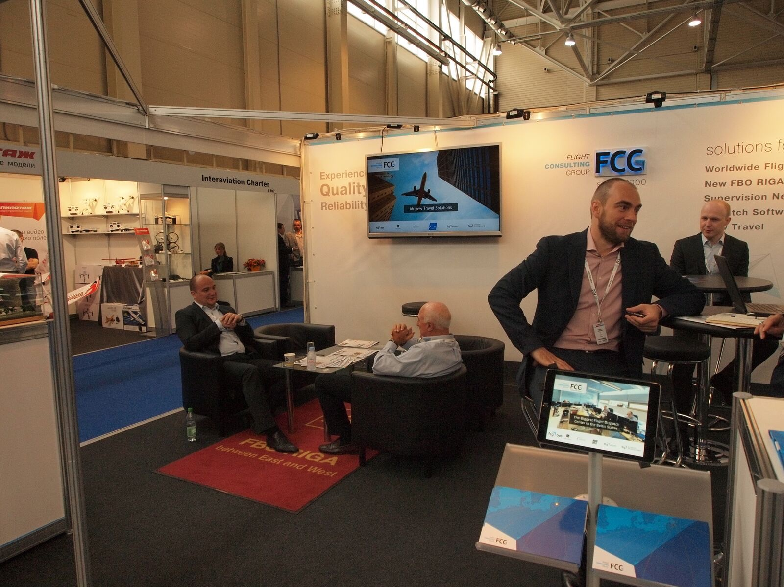
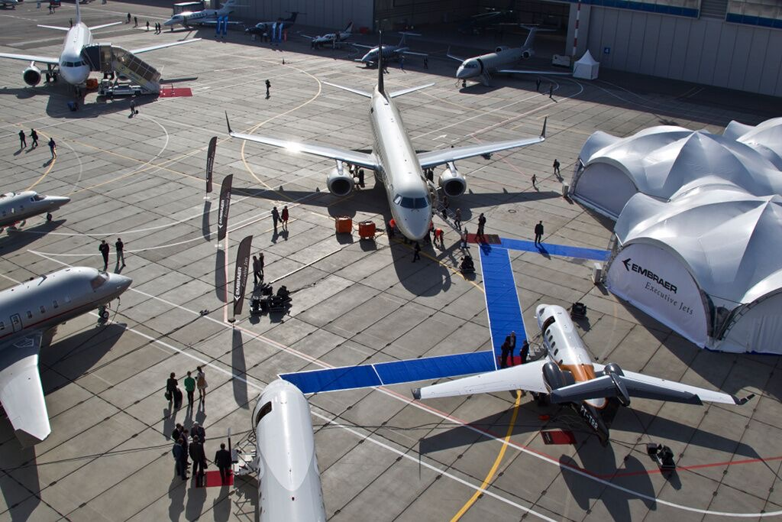
Integrated Marketing
Campaigns

Slide 5
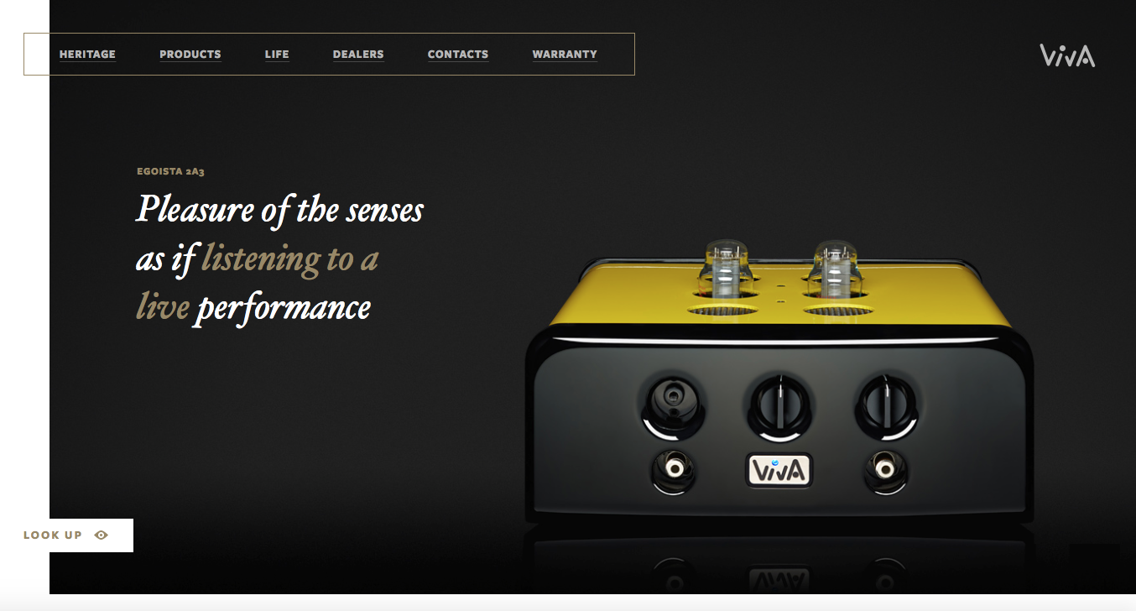
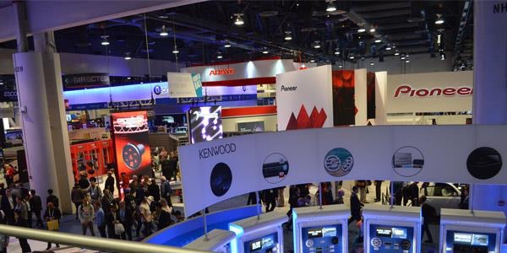
Market research at CES Audio Show in Las Vegas

Slide 6
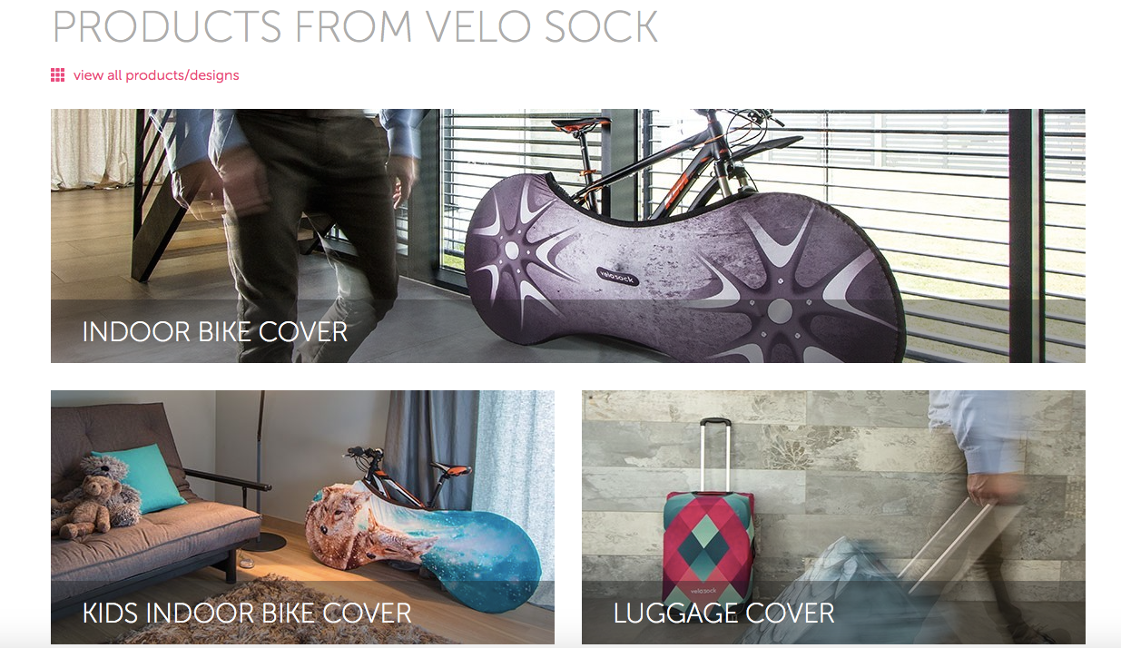
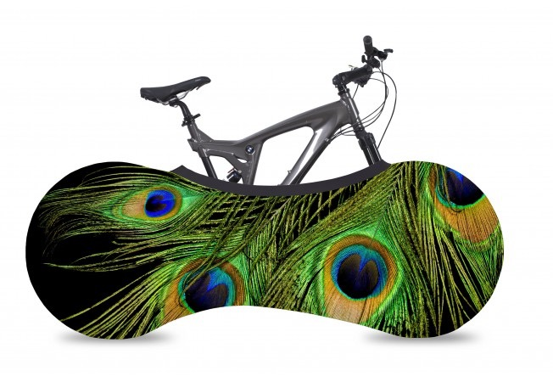
Start - up projects development
from Latvia

Slide 7
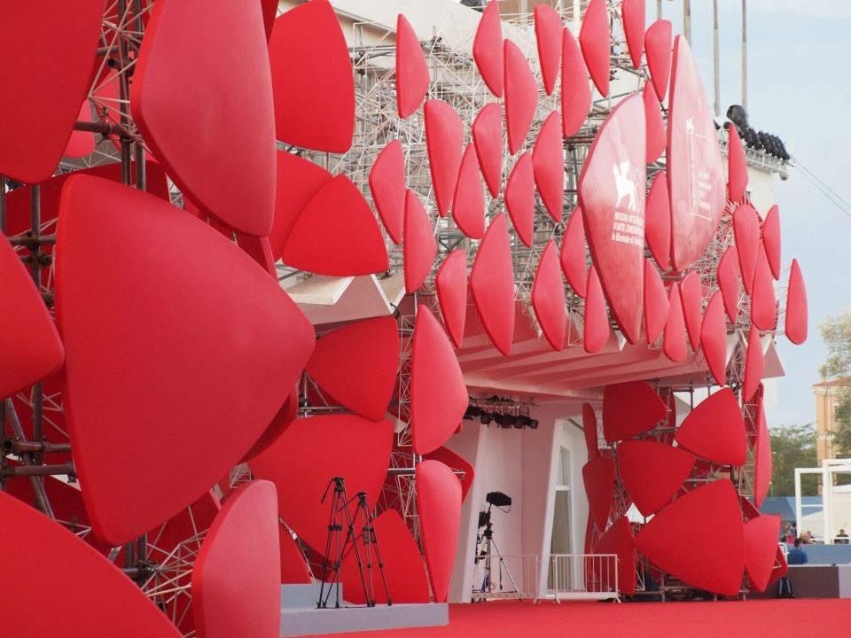
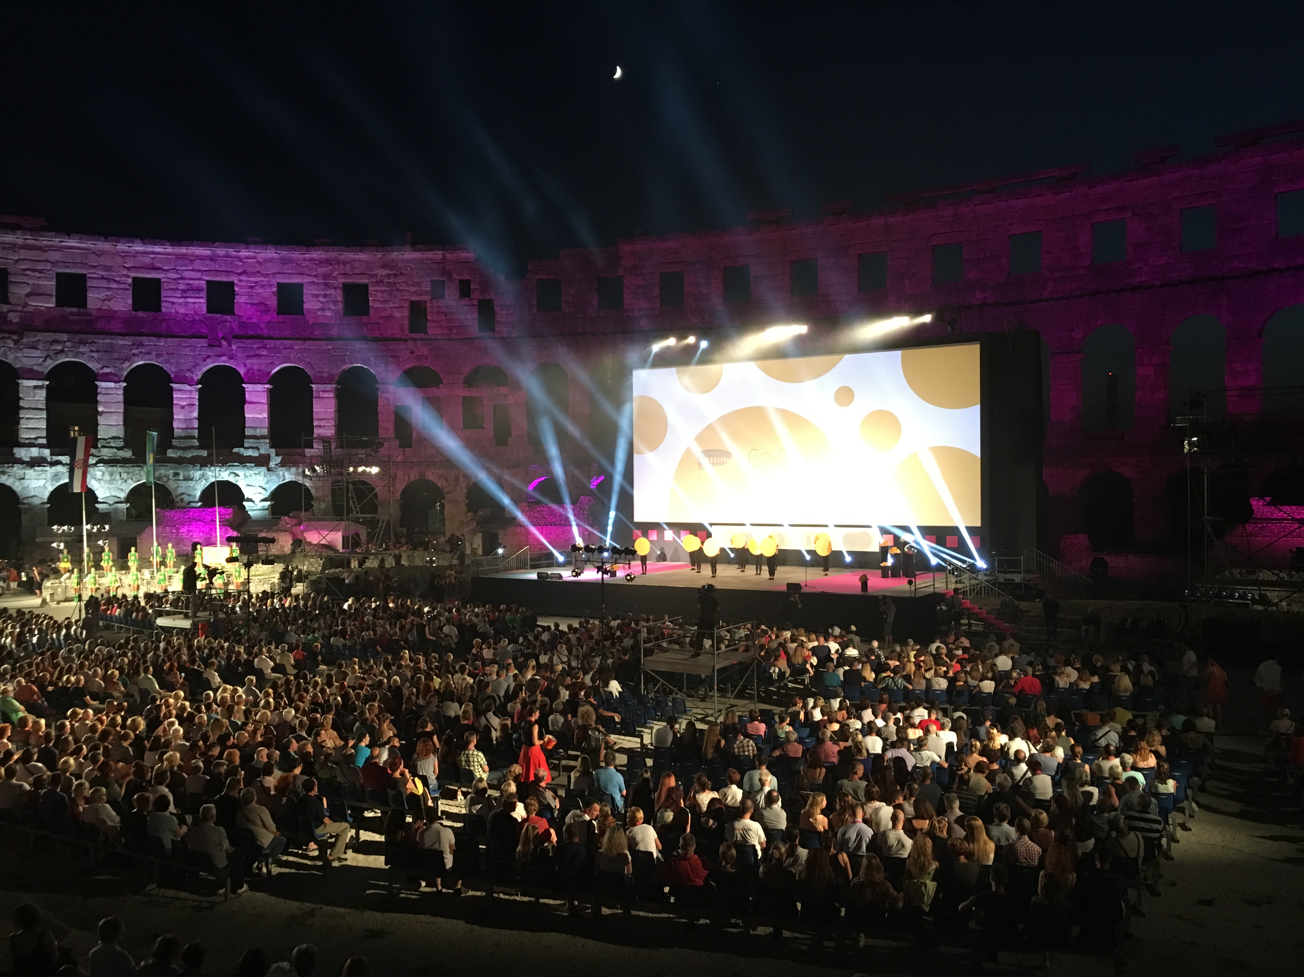
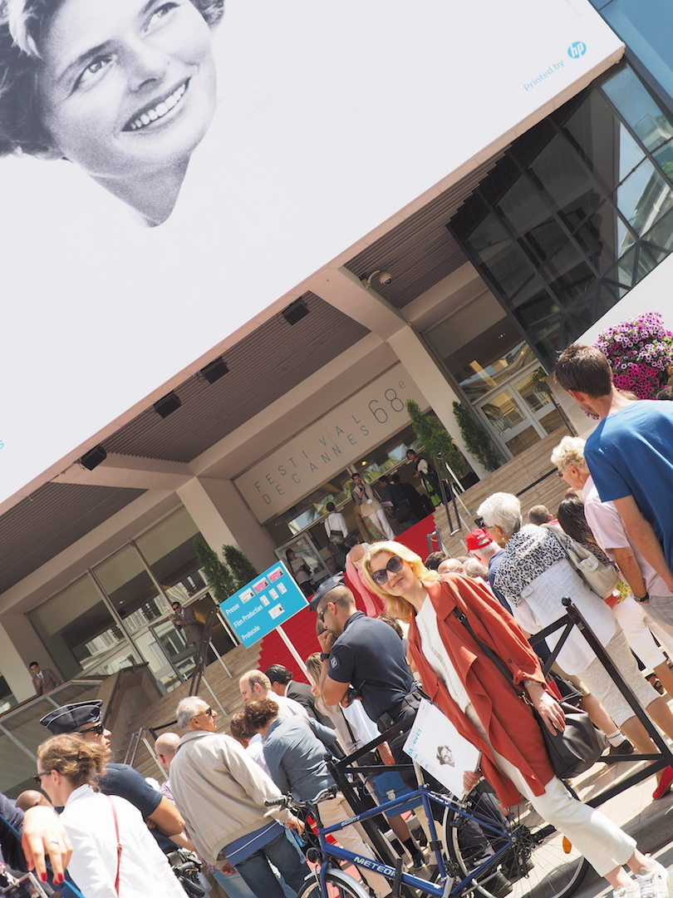
Public Relations at International Film Festivals in Europe and USA

Slide 8
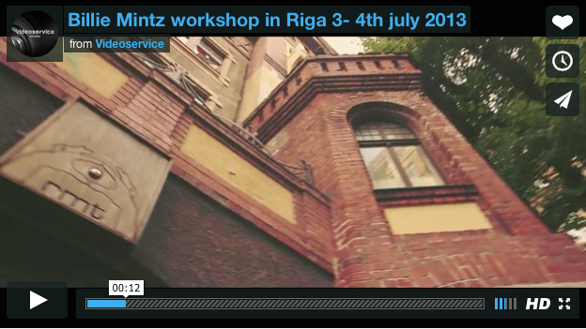
https://vimeo.com/channels/561790
Local Film Shooting

Slide 9
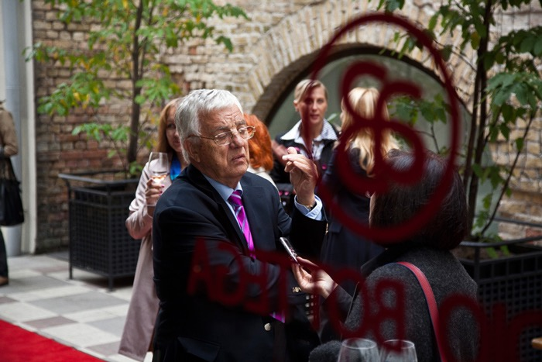
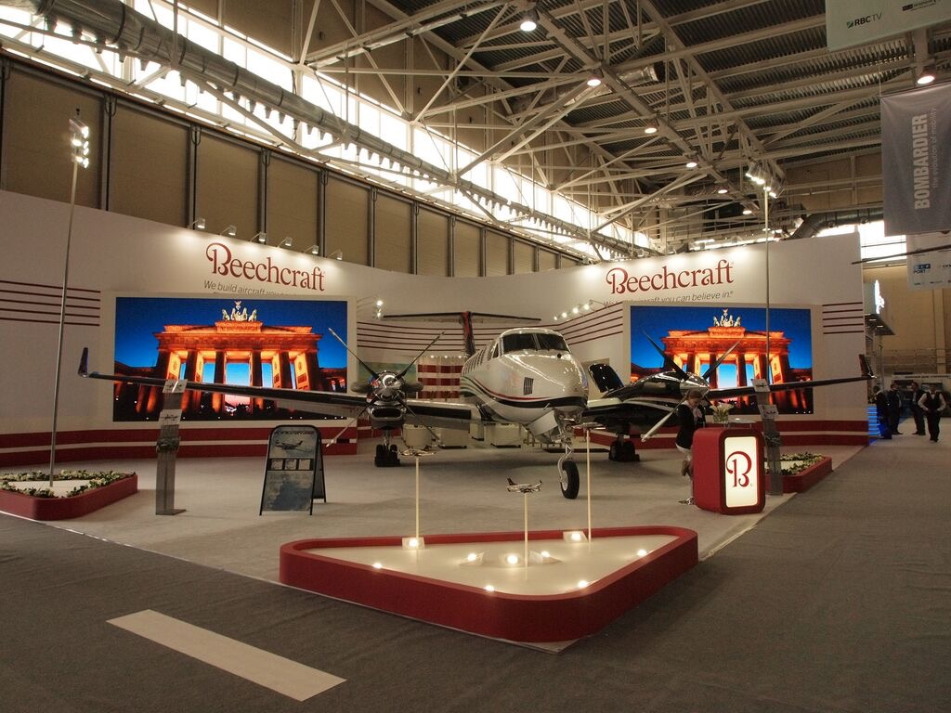
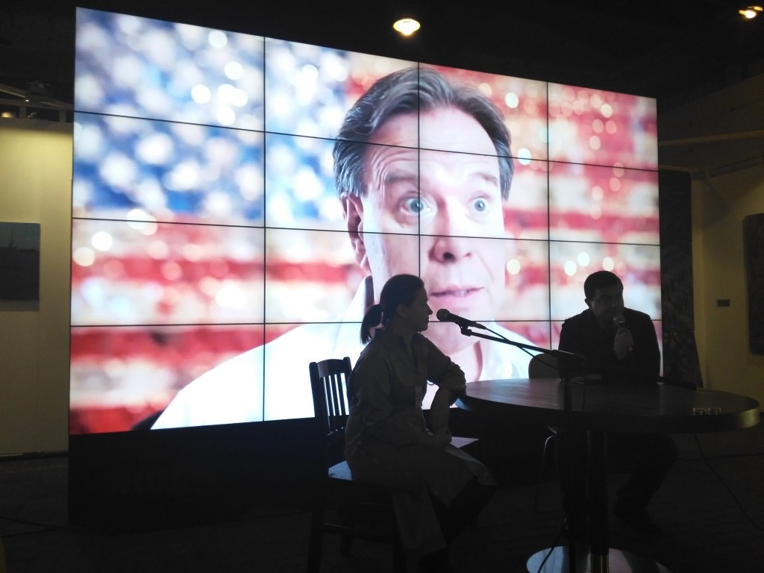
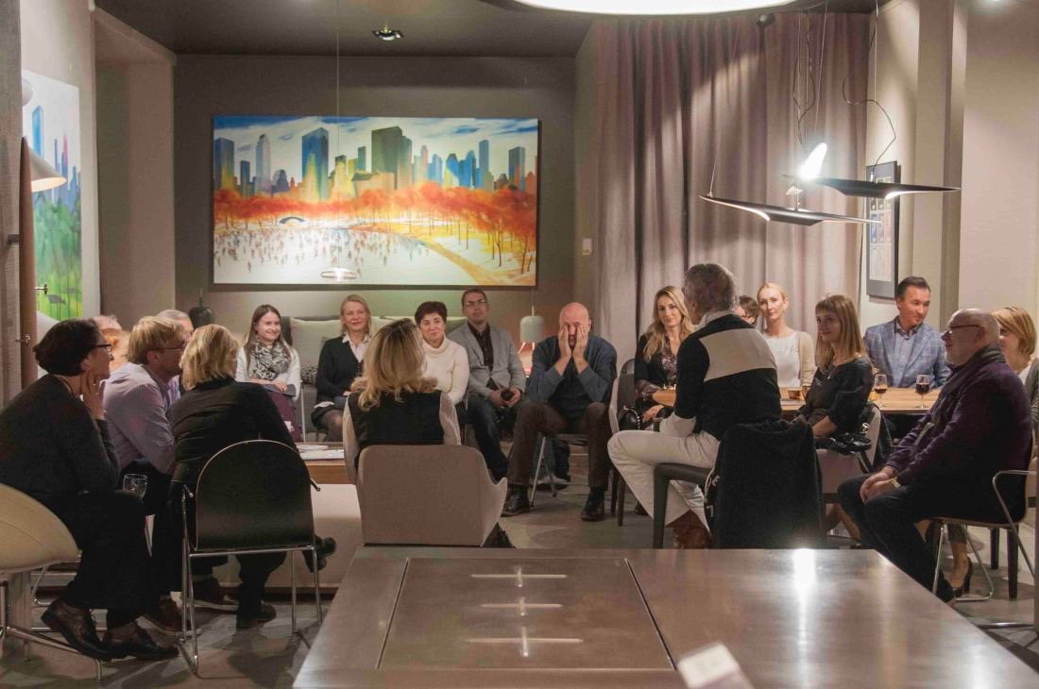
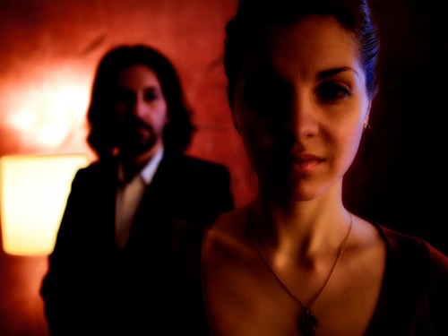
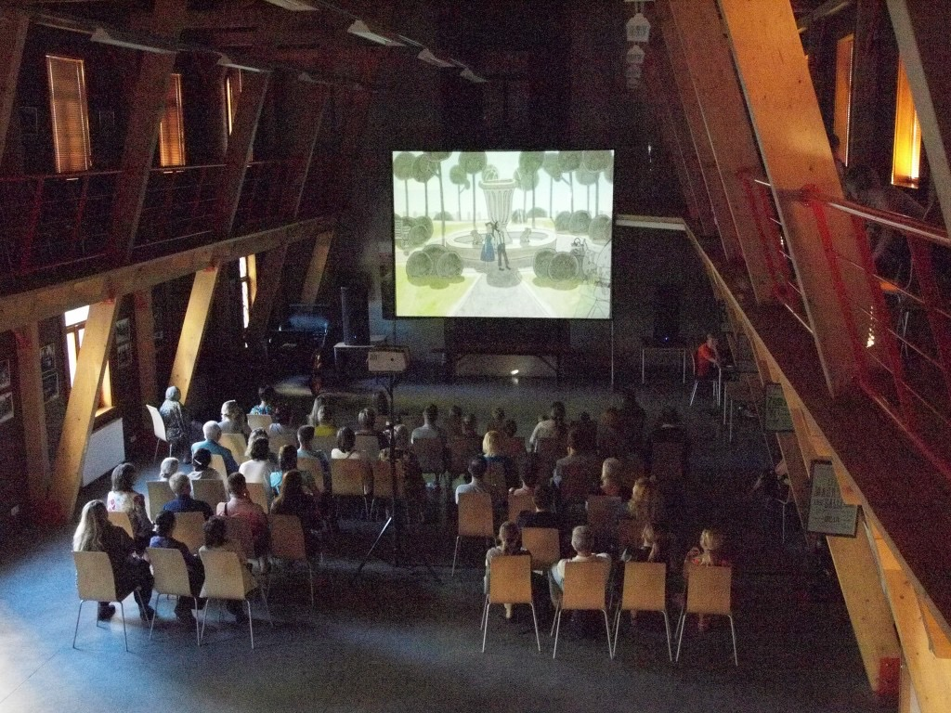
Grand Opening in Riga
JET EXPO Exhibition in Moscow
Riga Art Fair 2015
Press Conferences
Film production in Latvia
Screenings organisation

Slide 10
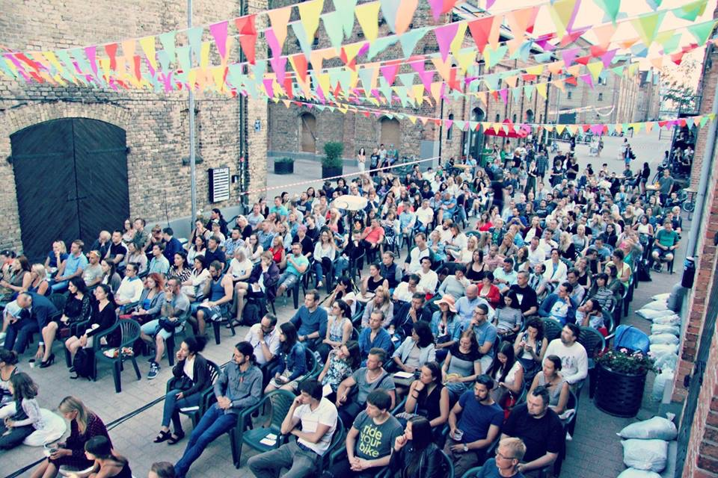
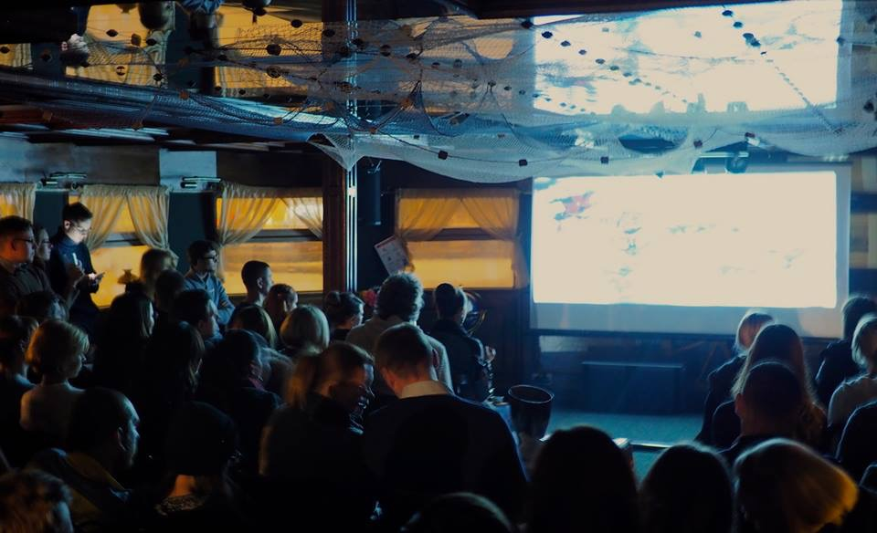
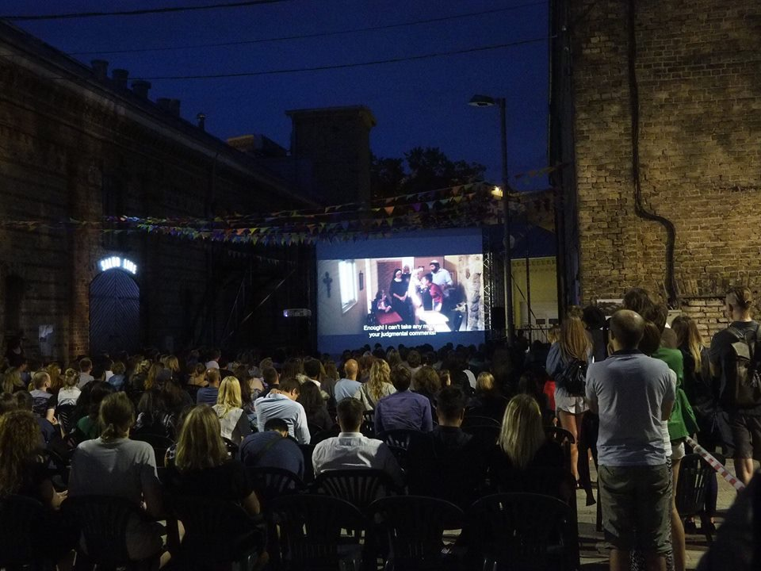
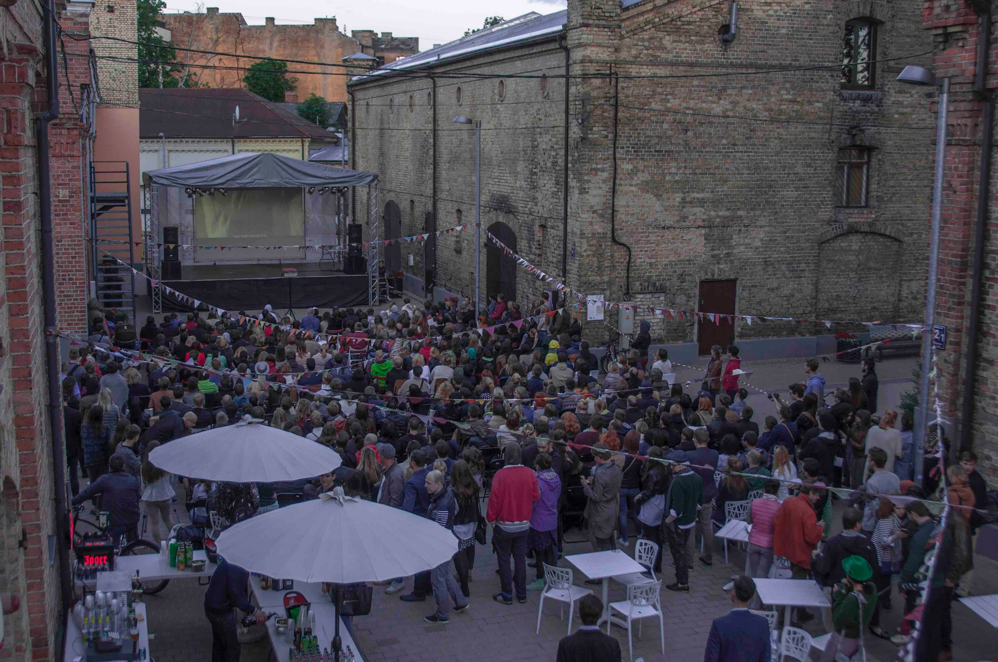
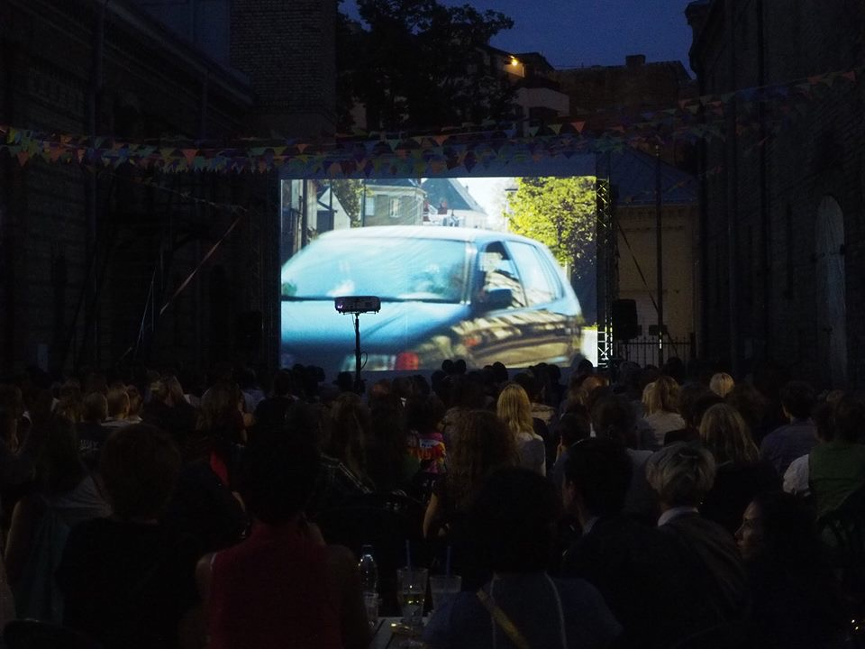

Slide 11
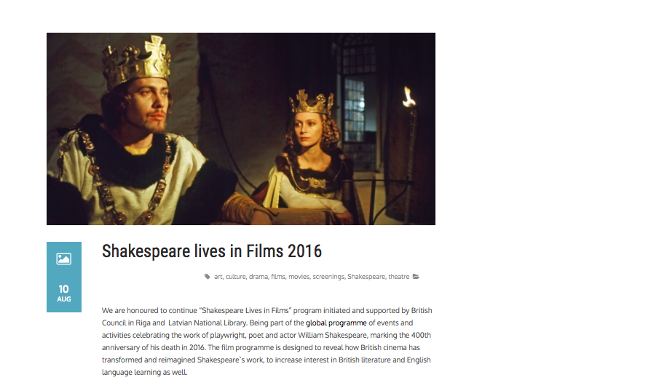

Slide 12
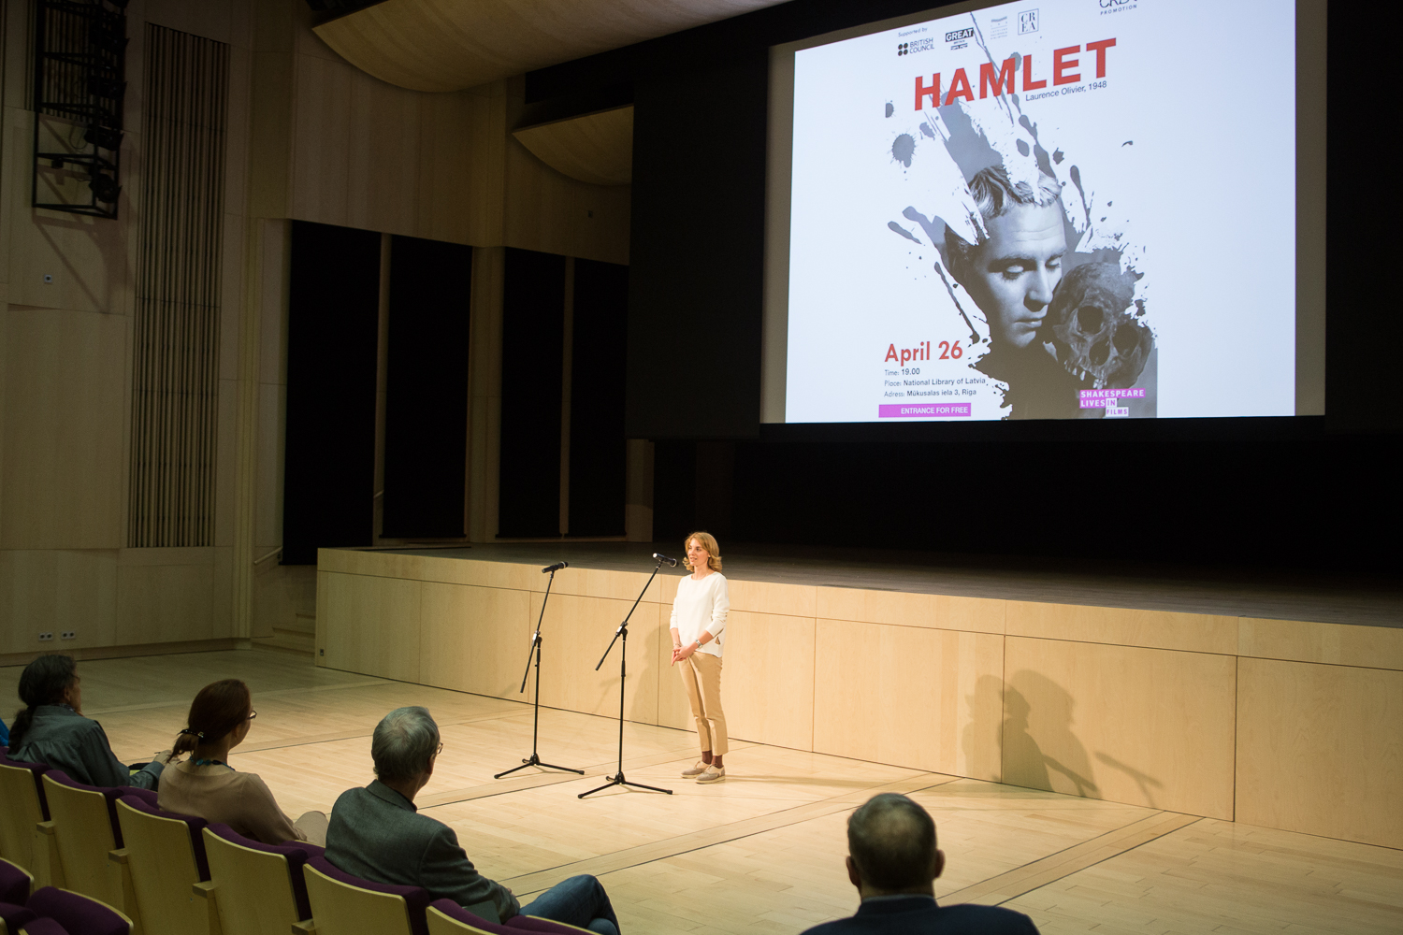
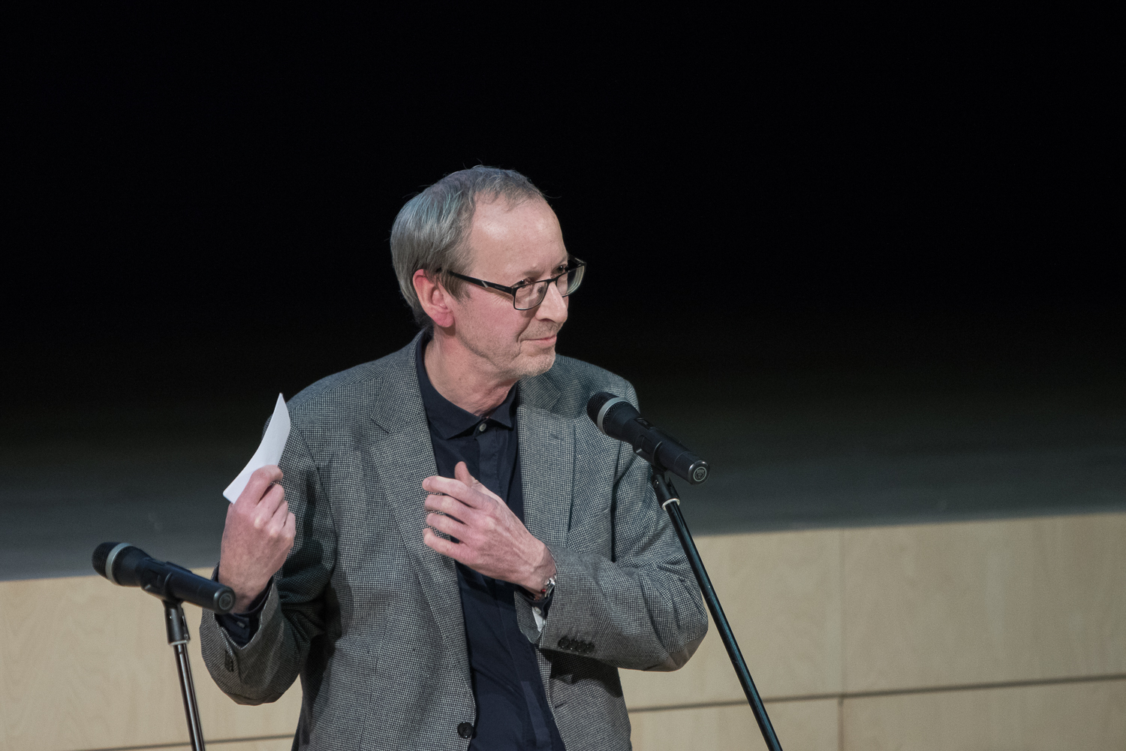
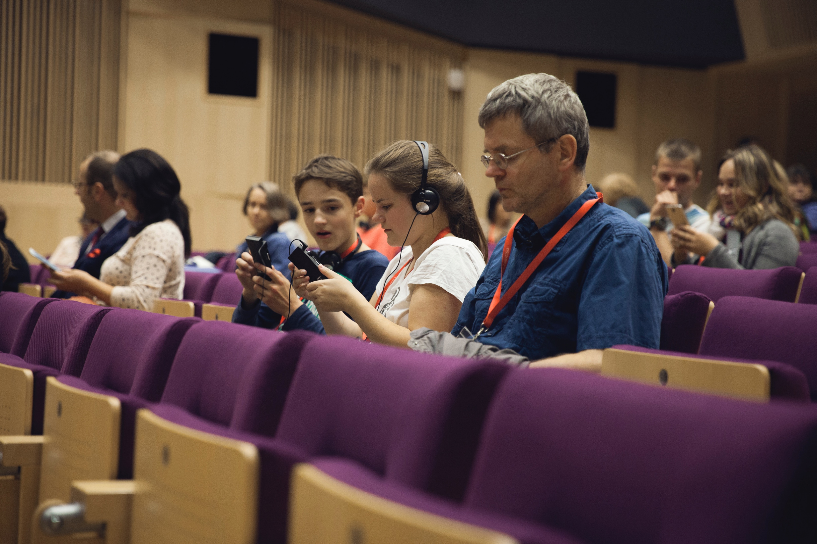
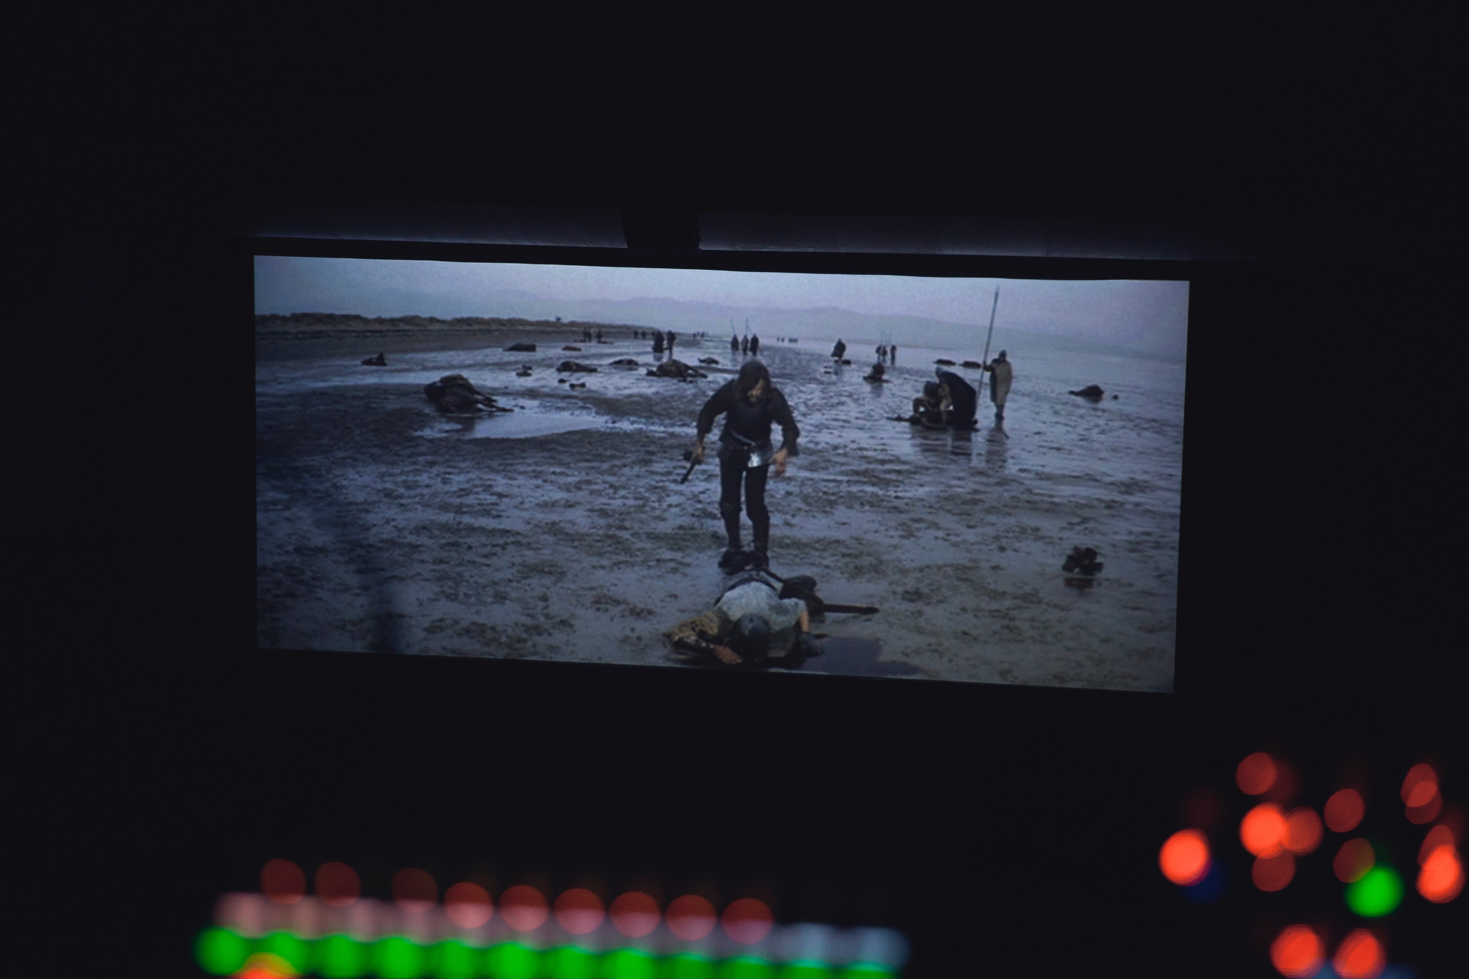
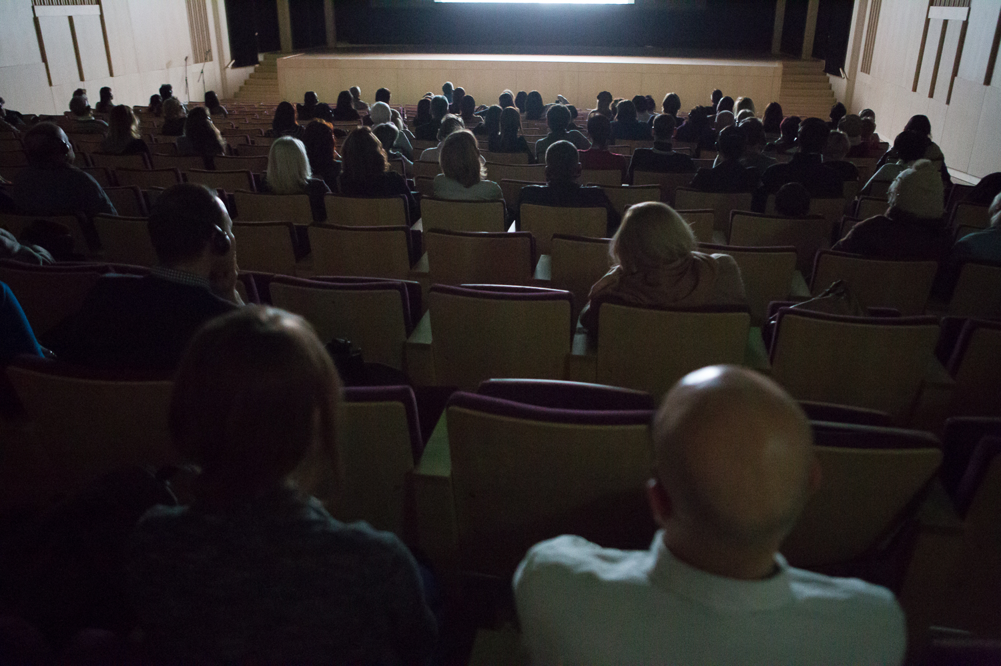
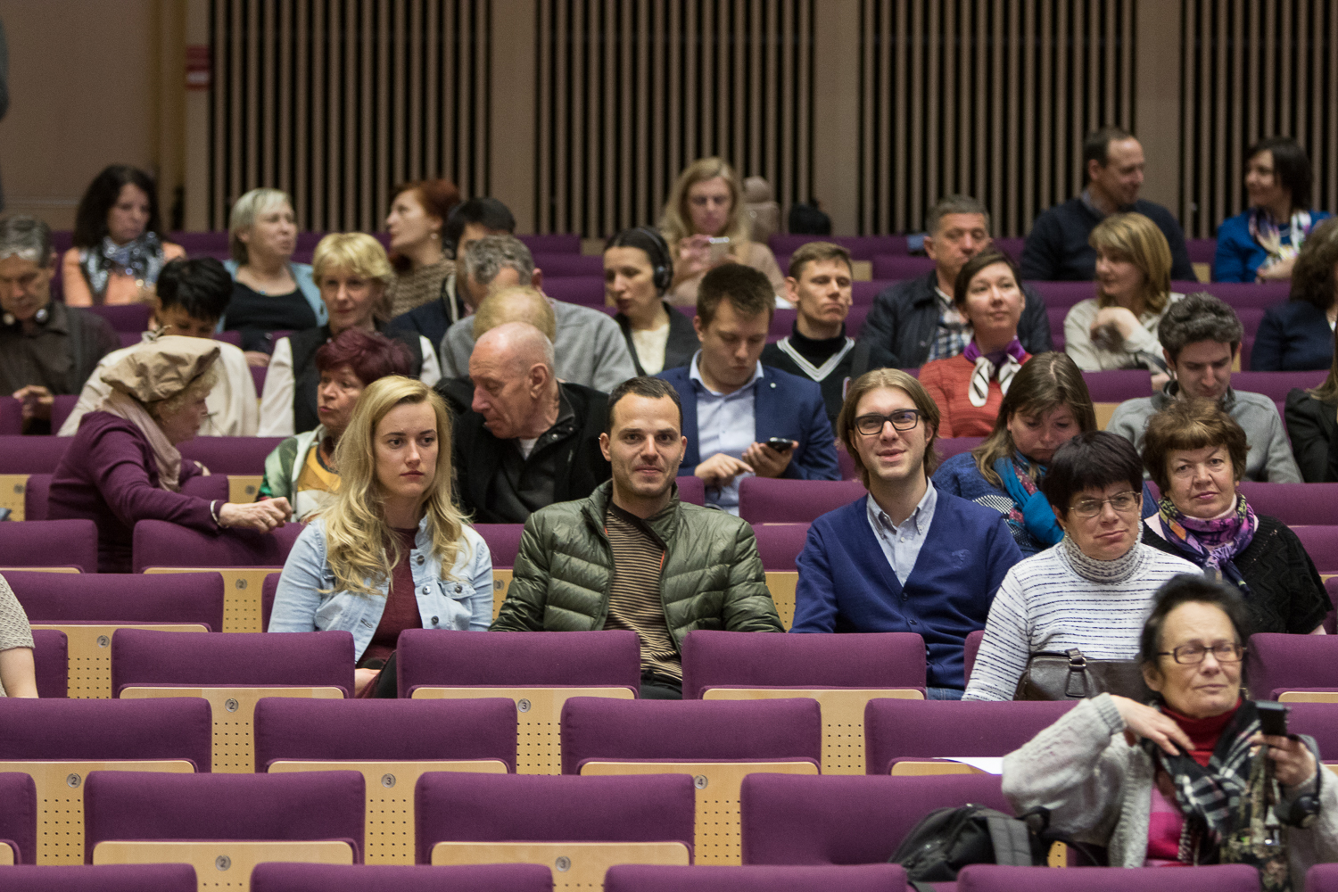
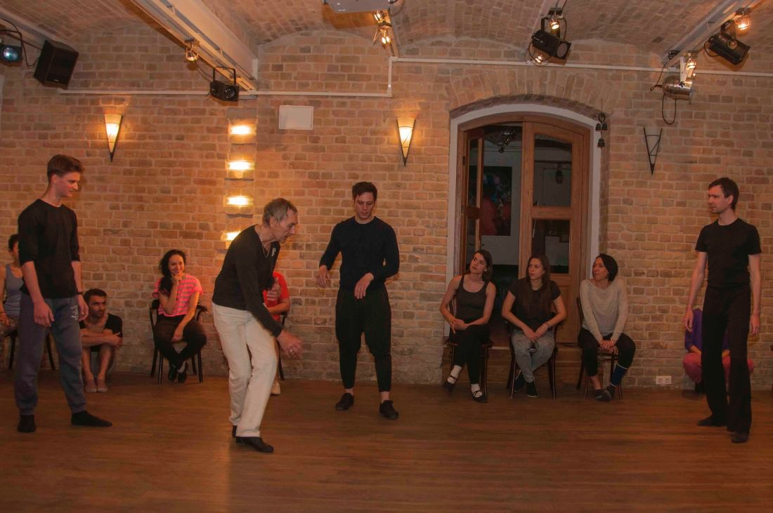
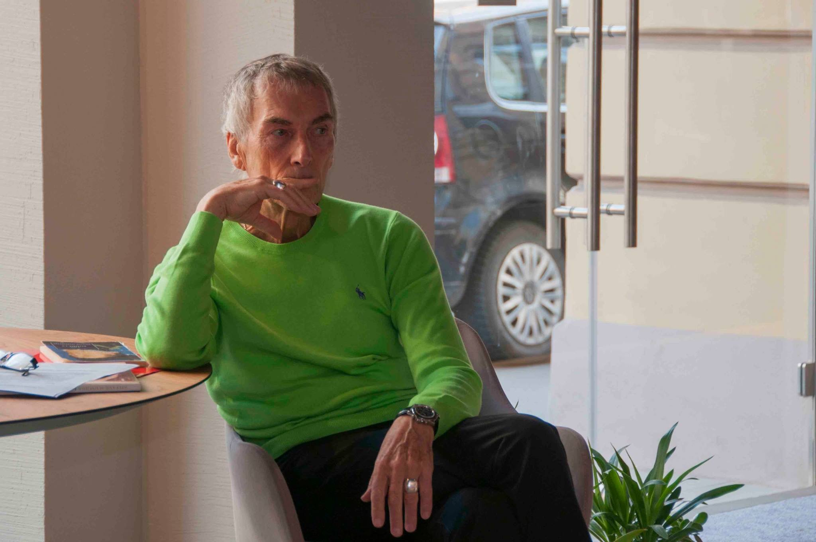

Slide 13
How can we raise Economy of Latvia
by making film festivals?

Slide 14
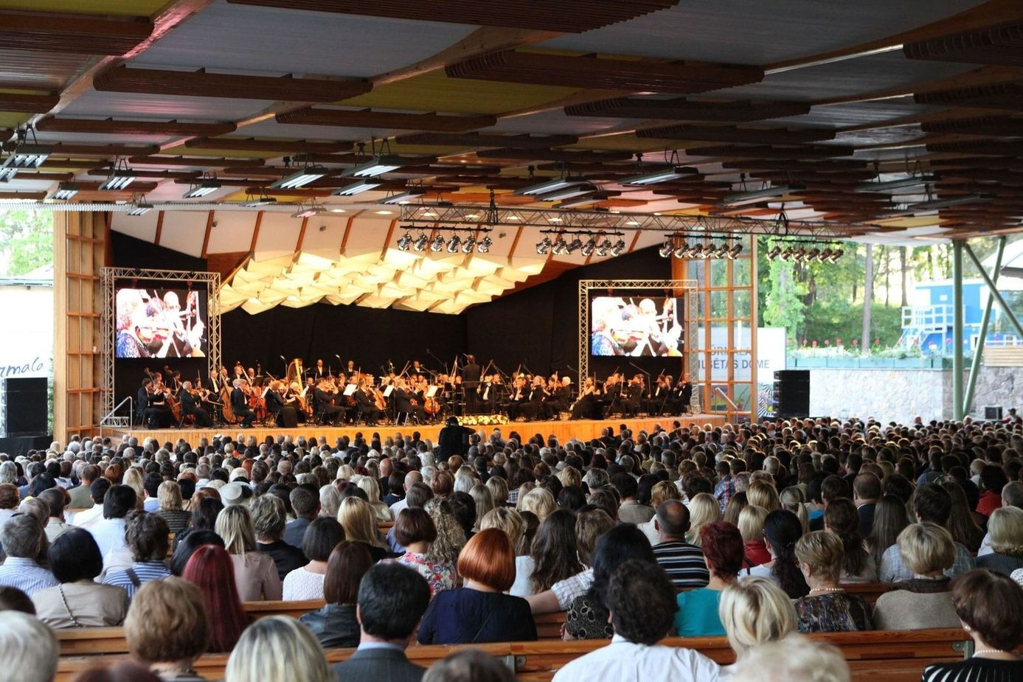
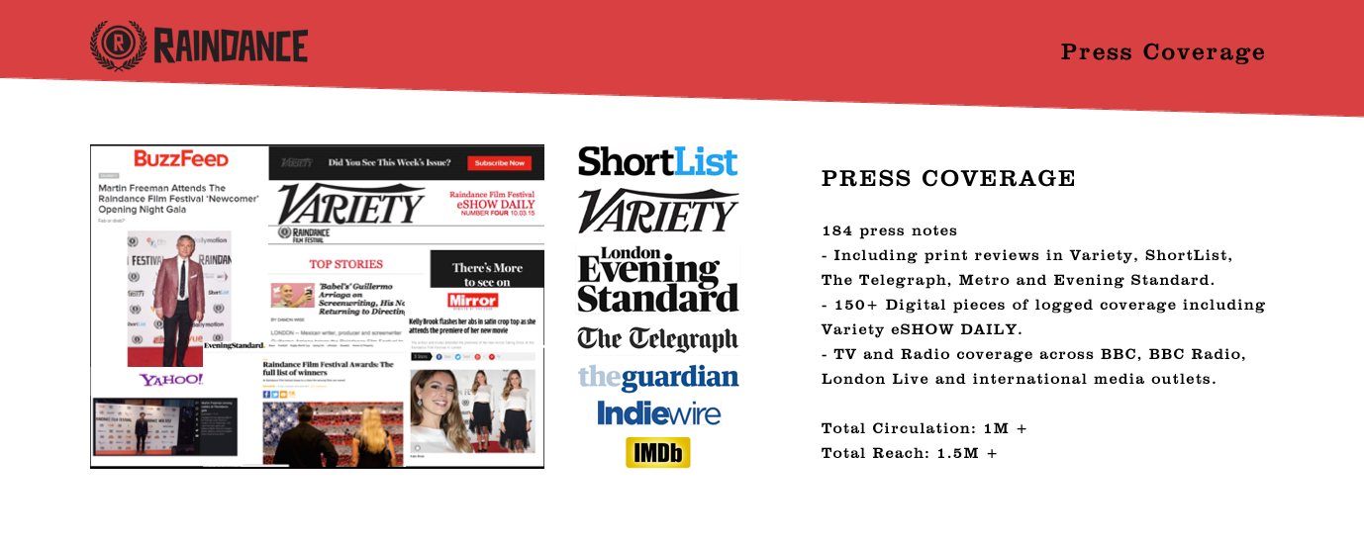
Solution: We invite celebraties, attract international press
and worldwide known film production companies
Vision: Within Raindance film festival we create the bridge between Baltic States, Western and Eastern Europe

Slide 15
Why well known film production companies should be interested in Latvia?

Slide 16
RIGA FILM FUND
Provides a tax rebate of up to 20% of all qualifying local spent during a foreign film production (feature, television and documentary films)
LATVIAN STATE SUPPORT FUND
A rebate of up to 20% to foreign productions shot in Latvia – feature films, animation films and documentaries.
LATVIA IS AN OFFICIAL MEMBER OF SEVERAL INTERNATIONAL INSTITUTIONS, which allows qualifying for international co-production funding. (National Film Fund, Euroimages, European Media).
LATVIA HAS A LOT OF CHARACTER, WELL-DEVELOPED INDUSTRY AND THE COSTS ARE AMONG LOWEST IN EUROPE

Slide 18
info@creapromo.com
www.creapromo.com

